Slide 1
DATA 6700 INDEPENDENT STUDY | SUMMER 2026
A Longitudinal Study of County
Health Insurance Coverage, 2010–2025
Seth Phillips

Slide 2
PROJECT OVERVIEW
How This Project Is Structured
How did county-level health insurance coverage in the United States change from 2010 to 2025, and which socioeconomic conditions move alongside it?
1
Part 1: Foundations
Panel construction, national trends, baseline models
2
Part 2: Panel Regression
Fixed effects, resolving an inconsistency in the data
Descriptive, not causal. The study quantifies and characterizes patterns in the data. It does not claim to establish cause and effect at any point.
3
Part 3: Heterogeneity and Validation
Trajectory clusters, income splits, Medicaid expansion
2

Slide 3
PART 1: FOUNDATIONS
Panel Construction
Approach
1
Built a county-year panel from sixteen annual County Health Rankings releases
2
FIPS harmonization and cross-year comparability checks
3
Described how the uninsured rate evolved nationally and across places
4
Fit baseline models: OLS, ridge, and lasso, plus a random forest as a check for nonlinearity

Slide 4
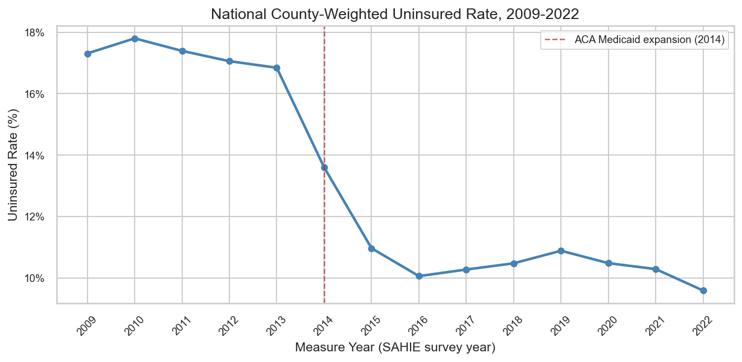
CHART: NATIONAL TREND
The National Uninsured Rate, 2009–2022
The population-weighted uninsured rate fell from about 17 percent to under 10 percent, almost entirely between 2013 and 2016.

Slide 5
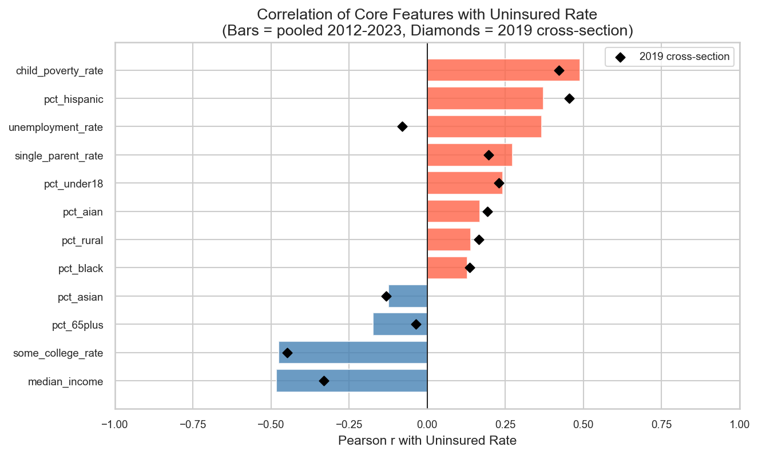
CHART: A WARNING SIGN
One Predictor Did Not Behave
unemployment_rate is the only predictor where the single-year relationship (diamond) sits on the opposite side of zero from the pooled relationship (bar).

Slide 6
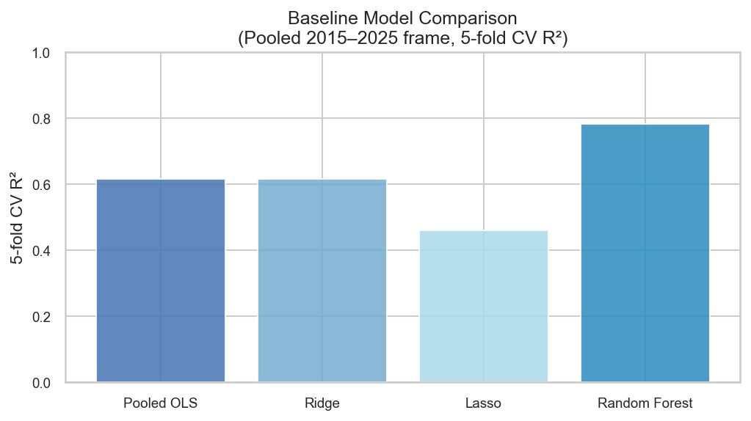
CHART: BASELINE MODELS
Checking for Nonlinearity
Random forest outperformed the linear models by about 0.17 R-squared. Ridge regression separately shrank the pct_white coefficient by 94 percent, exposing severe multicollinearity among the demographic predictors.

Slide 7
PART 1: FOUNDATIONS
Key Results
Panel Scale
Predictor Inconsistency
Model Check
43,873 county-year observations across 3,142 counties, 2012 to 2025.
unemployment_rate: r = 0.37 pooled across years, but r = -0.08 within a single year.
Random forest: +0.17 R-squared over linear models. Ridge: 94% shrinkage on pct_white.
The national insurance coverage was clear. But one predictor did not behave consistently depending on how the data was sliced.

Slide 8
PART 2: PANEL REGRESSION
Isolating Within-County Change
Approach
1
Moved from pooled regression to two-way fixed effects, separating within-county change from cross-county comparison
2
Applied specifically to resolve the unemployment_rate inconsistency found in Part 1
3
Ran a Mundlak test to confirm fixed effects was the statistically correct choice, not just a preference
4
Stress-tested the result with Driscoll-Kraay standard errors, a wider time window, and a descriptive event-time analysis

Slide 9
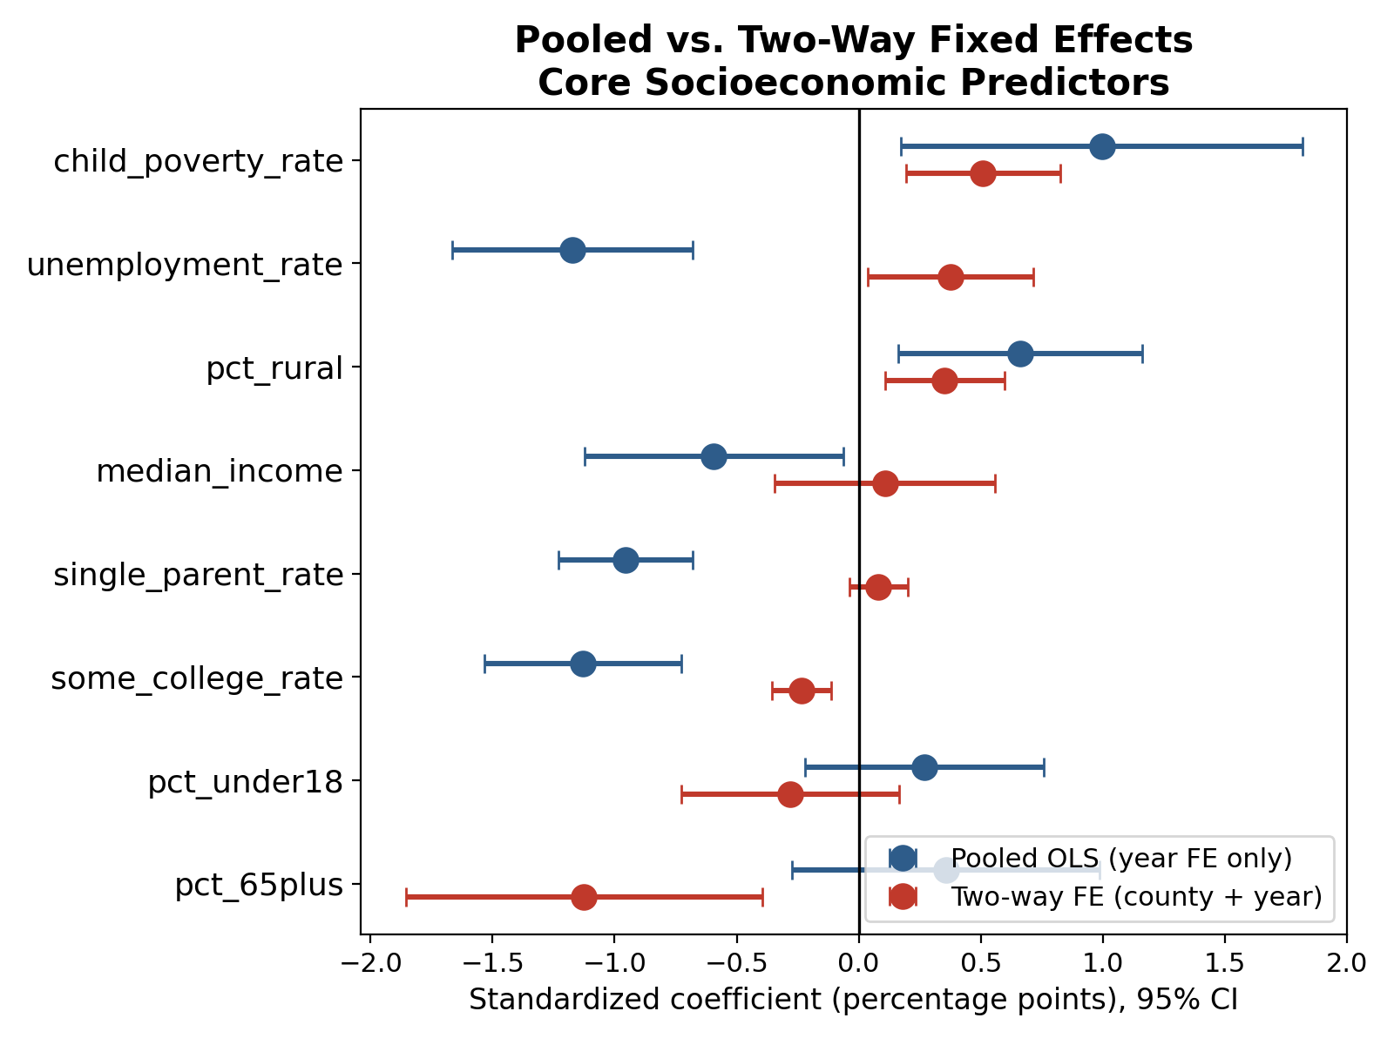
CHART: PART 2
Pooled vs. Two-Way Fixed Effects
unemployment_rate reverses sign under fixed effects: pooled coefficient -1.17 percentage points (p < 0.001) becomes +0.37 percentage points (p = 0.030).

Slide 10
PART 2: PANEL REGRESSION
Key Results
Core Finding
Mundlak Test
Driscoll-Kraay SE
Wider Window
unemployment_rate reverses sign: within the same county over time, rising unemployment is followed by a rising uninsured rate.
p < 0.0001: fixed effects confirmed as the statistically correct specification.
p = 0.0051: result holds under a robust, cross-sectionally aware standard error.
2012 to 2025: coefficient remains stable outside the original modeling window.
This is the most thoroughly validated finding in the project: it survived every check run against it.

Slide 11
PART 3: HETEROGENEITY AND VALIDATION
Testing Whether the Average Holds
Approach
1
Clustered counties by uninsured rate trajectory shape using K-means, selected K by silhouette score
2
Confirmed cluster stability across ten random seeds
3
Profiled the highest-uninsured counties against the rest of the sample
4
Refit the Part 2 model separately by income tercile, then ran a logistic regression connecting cluster membership to Medicaid expansion status

Slide 12
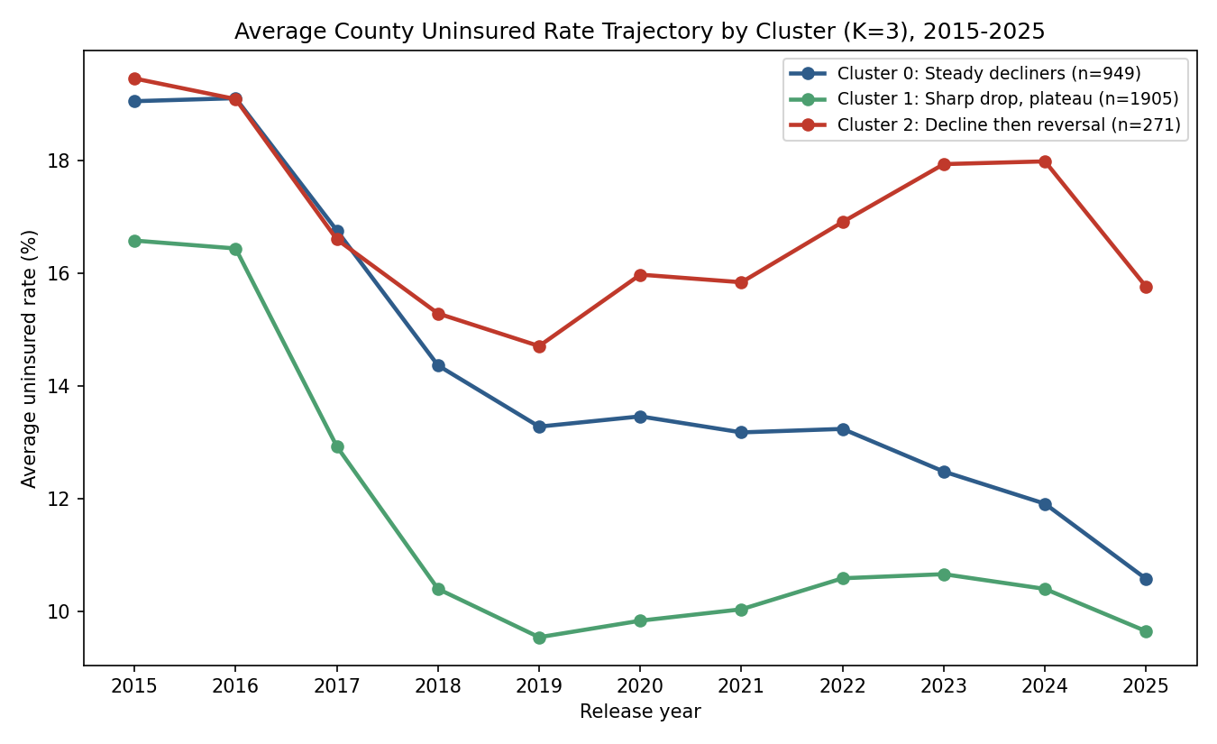
CHART: TRAJECTORY CLUSTERS
Three Coverage Trajectory Shapes
Steady decliners, a sharp-drop-then-plateau majority, and a smaller group of 271 counties whose coverage gains partially reversed after 2019.

Slide 13
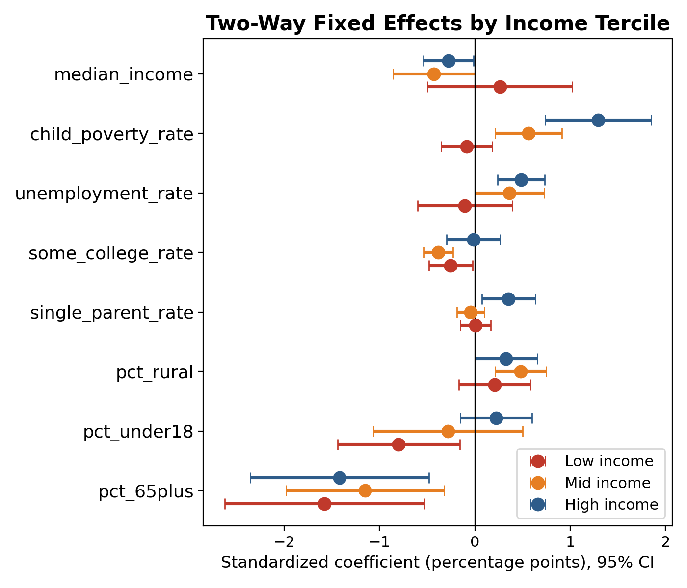
CHART: INCOME TERCILES
The Reversal Is Not Universal
unemployment_rate is not significant in low-income counties (-0.10 percentage points, p = 0.681), but is significant in mid- (+0.36 percentage points, p = 0.048) and high-income counties (+0.49 percentage points, p < 0.001).

Slide 14
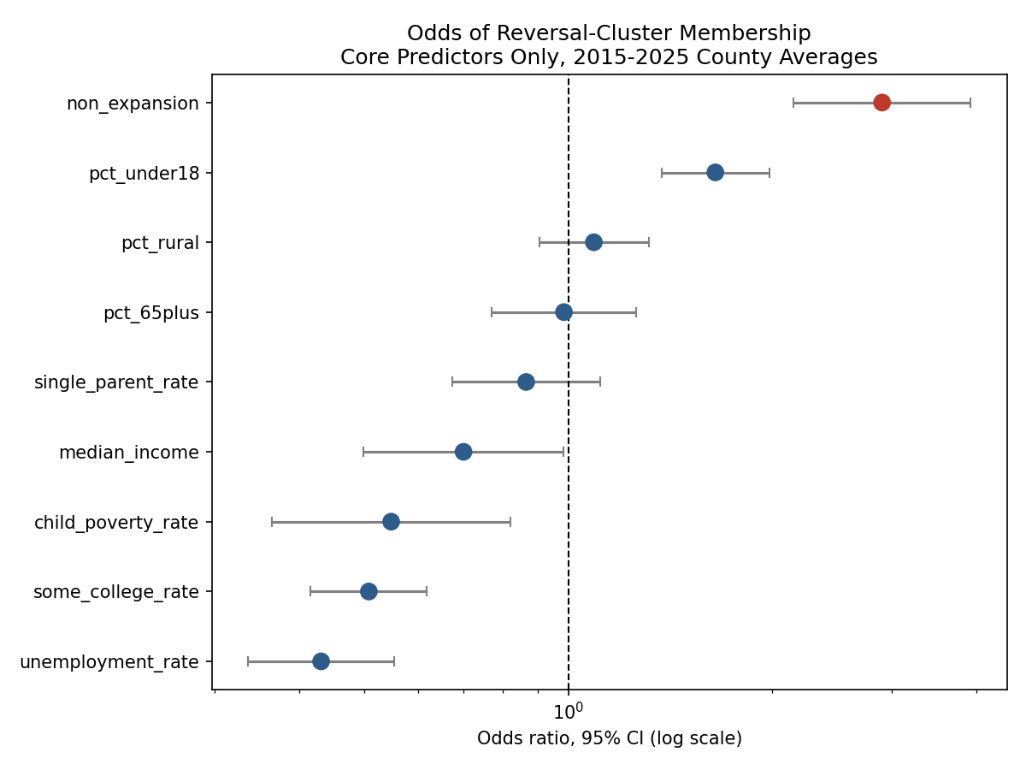
CHART: MEDICAID EXPANSION
Expansion Status Predicts Reversal
Non-expansion counties have roughly 3 times the odds of falling into the reversal cluster (95% CI: 2.15 to 3.93), controlling for income, poverty, education, and rurality.

Slide 15
PART 3: HETEROGENEITY AND VALIDATION
Key Results
Reversal Cluster
Income Split
Expansion Odds
271 counties with post-2019 coverage reversal. 40% non-expansion share, vs. 20% in the other clusters.
The unemployment_rate reversal is concentrated in mid- and high-income counties.
Non-expansion counties: ~3x the odds of falling into the reversal cluster, holding other factors constant.
Three separate analyses, trajectory shape, income subgroup, and expansion status, all pointed in the same direction: the pooled and fixed-effects results describe an average that does not hold for every county.

Slide 16
OVERALL TAKEAWAYS
Each part of this project exists because the previous part's result turned out to be an average hiding something that mattered.
Part 1
A pooled correlation hid a shared national time trend.
Part 2
A fixed-effects coefficient, the project's most validated result, hid an income-dependent split.
Part 3
Stopped averaging and asked for whom each result was actually true.
The project's real finding is not any single coefficient. It is a demonstration that an average result cannot be trusted until you try to break it apart and see if it still holds.

Slide 17
Thank You
A Longitudinal Study of County Health Insurance Coverage, 2010–2025
Seth Phillips | DATA 6700 Independent Study | Summer 2026
sphillips32/A-Longitudinal-Study-of-County-Health-Insurance-Coverage-2010-2025

